Slide 1
SIFL - Technical Design

Slide 2
Overview of changes
UI Improvements.
UI Refactoring
Clear/Undo task schedule
Import KPs filter
Micro Tanker UI modification
KOKOpoint refuel task UI modification
Backend Changes.
Multiple MT Refill tasks
Distance of the refuel task
Full Tank of Task.

Slide 3
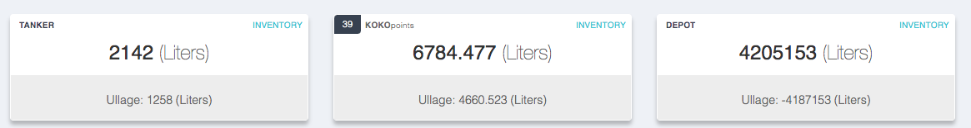

UI Improvements
Change the whole refilling UI from snabbdom to Vuejs(To support future KOKO frontend microservice)
Remove the Ullage information of tanker and the depot
3. Change the page coordinates and state to websocket approach.
3. Remove Optimize Route and Refresh button
4. In Collapse view KP id will be replaced by Shop Id

Slide 4
UI Improvements
Clear/Undo task Schedule
Initially the schedule section would be empty.
On click of clear button all the kp task will be moved to unschedule section.
Will not work if any of the task will be in the following states:
EN_ROUTE
READY_FOR_REFILL
REFILLING
REFILLING_COMPLETE
RECEIVING_COMPLETE
COMPLETE
On click of UNDO button all the KP task will move back to schedule section, that were moved to unschedule section by CLEAR button.

Slide 5
UI Improvements
Import Shops Filter
Import Shops using Stock filter
Formula: 0-4 stock days in ascending order
Import Shops using Ullage filter
Formula: Ullage in descending order

Slide 6
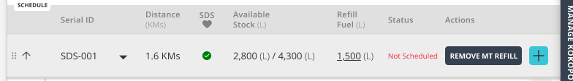
UI Improvements
Micro Tanker Refill
UI modification
Support for Multiple MT refills
Distance Calculation
Micro tanker distance is from assigned SDS to previous field system refill
If the Mt refill is in the first position then distance is from MT to assigned SDS

Slide 7
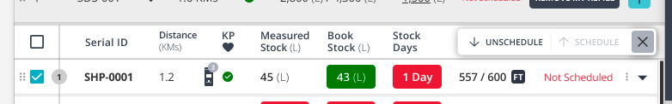
UI Improvements
KOKOpoint Refill Task
Header UI Improvements
Select all checkbox for both schedule and unschedule section
Dashboard settings panel would be fixed on the screen
Can move the selected KPs to schedule/unschedule section
Max Shops in Schedule section is limited to 8(Configurable from backend)

Slide 8
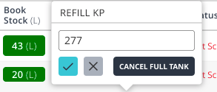
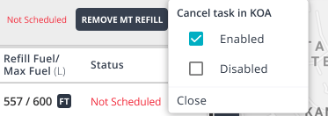
UI Improvements
KOKOpoint Refill Task
Schedule/Unschedule Task Improvements
Checkbox will be added to all task to move task from schedule to unschedule or vice-versa.
Collapse View
-
Collapse section, contains the information about the shop
Distance is from the field system of previous task.
Show the number of KPs if the number is greater than 1
Out of service/In service info(Out of service if any of the KP is out of service)
On hover over out of service icon, show the error code on it.
Color of MS/BS changes to RED is the difference is more than 15L(Configurable)
BS will be responsible for refill fuel
Default will be total-BS and we can also set it to Full Tank if there will be 1 KP in that shop
KOA cancel task option is moved to three dots option

Slide 9
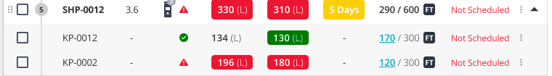
UI Improvements
KOKOpoint Refill Task
Schedule/Unschedule Task Improvements
Checkbox will be added to all task to move task from schedule to unschedule or vice-versa.
Expanded View
-
KP will be in nested view of the shop
Move a specific KP to Schedule/Unschedule section. It will create a separate Shop entry in another section if moved.
NOTE: KP’s inside same shop cannot be in different position inside the same section(Schedule/Unschedule)

Slide 10
Backend Changes
Distance of Task
Postgres Table Schema
Table Name: field_system_route_distance
Columns: source_field_system, source_id, destination_field_system, destination_id, distance_in_meters, distance_refreshed_at
Check if distance present in postgres or not
If no get the distance from google routes
postgres
Google routes
UI
KOKO Core
If yes return the distance from postgres

Slide 11
Backend Changes
Multiple MT refills
Mt refill tasks use of position_in_schedule of micro_tanker_refill_task table.
While returning list of task of a schedule return order by list from position_in_schedule.
Mt refill can be at any position inside the schedule
Other Changes
Get In service/Out of service information from Backend
Refill fuel will be calculated from BS not from the old logic(Greater of BS and MS)
Shop ID
Fetch ERP Lead ID and assign the lead id to the corresponding KP(ERP Changes)
Column name: erp_lead_id
Show the erp_lead_id in the UI

Slide 12
Full Tank
Add is_full_tank column in below tables:
Micro_tanker_refill_task
fuel_point_refuel_task
Ready for Refill API
Is_full_tank value will be default to True
If is_full_tank is true:
On ready for refill API update the requested_ml of the respective task
Requested_ml would be normal_refill_tank - book_stock at that time
Update the schedule and remove the task that will not fit into the task due to remaining volume of Micro tanker(Take Another MT refill into consideration also)
Moving Task from Schedule to Unschedule Formula:
Sum(Available volume MT + Planned Refill Vol of MT) - Sum(Planned Refill Vol of KP)

Slide 13
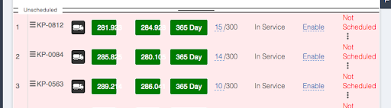
Questions
Collapse view would remain as is in the refilling section?
Replace KP id with the Shop Id
If State of any task is not equal to Not schedule/Schedule then clear and undo button will not work?
Clear and Undo button will be disabled in that case
How we will calculate stock days of the Shop instead of KPs?
Treat the Shop as a big KP comprises of all the KPs that are in the Shop
The feature of assigning a KP to another micro tanker would still be there?
Yes

